Slide 1




A Complete Guide to Programming in C++
Chapter 13 – Defining Classes

Slide 2
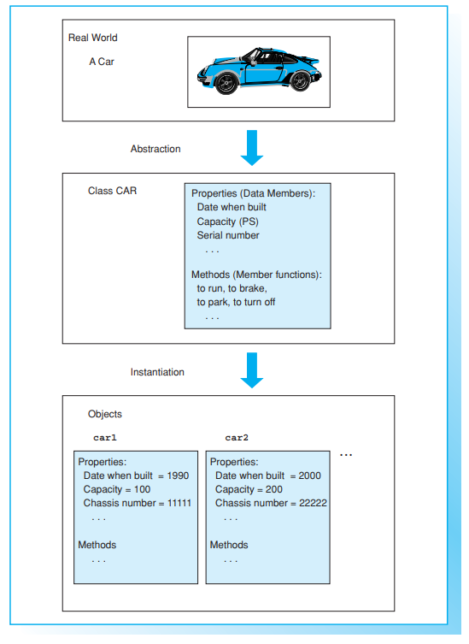

The Class Concept
Classes are the language element in C++ most important to the support object-oriented programming (OOP). A class defines the properties and capacities of an object.

Slide 3
Data Abstraction
Humans use abstraction in order to manage complex situations. Objects and processes are reduced to basics and referred to in generic terms. Classes allow more direct use of the results of this type of abstraction in software development.
The first step towards solving a problem is analysis. In object-oriented programming, analysis comprises identifying and describing objects and recognizing their mutual relationships. Object descriptions are the building blocks of classes.
In C++, a class is a user-defined type. It contains data members, which describe the properties of the class, and member functions, or methods, which describe the capacities of the objects. Classes are simply patterns used to instantiate, or create, objects of the class type. In other words, an object is a variable of a given class

Slide 4
Data Encapsulation
When you define a class, you also specify the private members, that is, the members that are not available for external access, and the public members of that class. An application program accesses objects by using the public methods of the class and thus activating its capacities.
Access to object data is rarely direct, that is, object data is normally declared as private and then read or modified by methods with public declarations to ensure correct access to the data.
One important aspect of this technique is the fact that application programs need not be aware of the internal structure of the data. If needed, the internal structure of the program data can even be modified. Provided that the interfaces of the public methods remain unchanged, changes like these will not affect the application program. This allows you to enhance an application by programming an improved class version without changing a single byte of the application.
An object is thus seen to encapsulate its private structure, protecting itself from external influences and managing itself by its own methods. This describes the concept of data encapsulation concisely.

Slide 5
Defining classes
A class definition specifies the name of the class and the names and types of the class members.
The definition begins with the keyword class followed by the class name. The data members and methods are then declared in the subsequent code block. Data members and member functions can belong to any valid type, even to another previously defined class. At the same time, the class members are divided into:
private members, which cannot be accessed externally
public members, which are available for external access.
The public members form the so-called public interface of the class.

Slide 6
Defining classes
EXAMPLE: Defining the class account
The private section generally contains data members and the public section contains the access methods for the data. This provides for data encapsulation.
The following example includes a class named Account used to represent a bank account. The data members, such as the name of the account holder, the account number, and the account balance, are declared as private. In addition, there are two public methods, init() for initialization purposes and display(), which is used to display the data on screen.

Slide 7
Defining classes
The labels private: and public: can be used at the programmer’s discretion within a class:
you can use the labels as often as needed, or not at all, and in any order. A section marked as private: or public: is valid until the next public: or private: label occurs
the default value for member access is private. If you omit both the private and public labels, all the class members are assumed to be private.

Slide 8
Naming
Every piece of software uses a set of naming rules. These rules often reflect the target platform and the class libraries used. For the purposes of this book, we decided to keep to standard naming conventions for distinguishing classes and class members. Class names begin with an uppercase letter and member names with a lowercase letter.
Members of different classes can share the same name. A member of another class could therefore also be named display().

Slide 9

Defining Methods
A class definition is not complete without method definitions. Only then can the objects of the class be used.
When you define a method, you must also supply the class name, separating it from the function name by means of the scope resolution operator ::
Failure to supply the class name results in a global function definition
Within a method, all the members of a class can be designated directly using their names. The class membership is automatically assumed. In particular, methods belonging to the same class can call each other directly.
Access to private members is only possible within methods belonging to the same class. Thus, private members are completely controlled by the class.
Defining a class does not automatically allocate memory for the data members of that class. To allocate memory, you must define an object. When a method is called for a given object, the method can then manipulate the data of this object.

Slide 10
Modular Programming
A class is normally defined in several source files. In this case, you will need to place the class definition in a header file. If you place the definition of the class Account in the file Account.h, any source file including the header file can use the class Account.
Methods must always be defined within a source file. This would mean defining the methods for the class Account in a source file named Account.cpp, for example.
The source code of the application program, for example, the code containing the function main, is independent of the class and can be stored in separate source files. Separating classes from application programs facilitates re-use of classes.
In an integrated development environment, a programmer will define a project to help manage the various program modules by inserting all the source files into the project. When the project is compiled and linked, modified source files are automatically re-compiled and linked to the application program
EXAMPLE: Methods of class Account

Slide 11

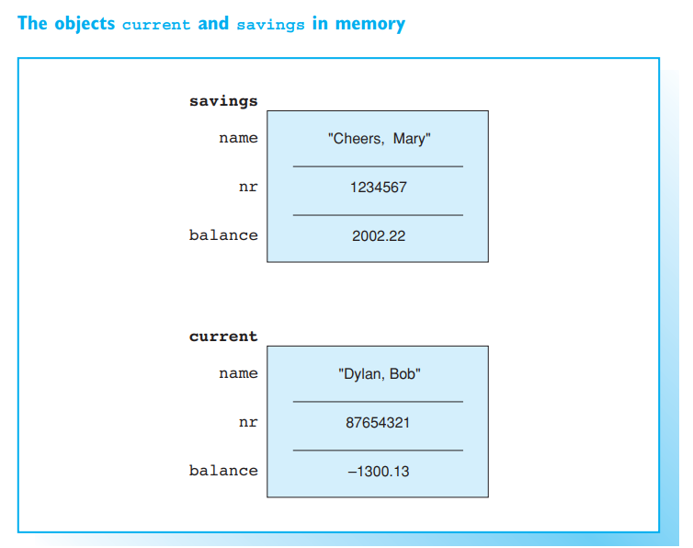

Defining Objects
Defining a class also defines a new type for which variables, that is, objects, can be defined.
An object is also referred to as an instance of a class.

Slide 12
Defining Objects
An object is defined in the usual way by supplying the type and the object name.
The following statement defines an object current of type Account:
Memory is now allocated for the data members of the current object. The current object itself contains the members name, nr, and balance.

Slide 13
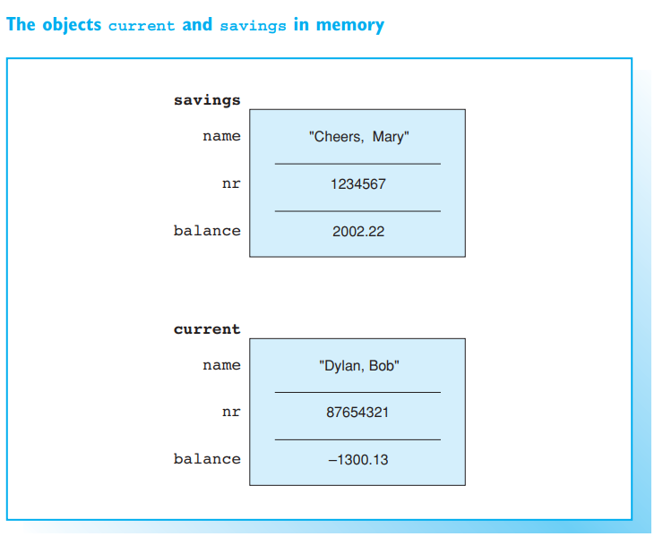

Objects in Memory
If multiple objects of the same class type are declared, as in each object has its own data members. Even the object savings contains the members name, nr, and balance. However, these data members occupy a different position in memory than the data members belonging to current.
The same methods are called for both objects. Only one instance of the machine code for a method exists in memory—this applies even if no objects have been defined for the class.
A method is always called for a particular instance and then manipulates the data members of this object. This results in the memory content as shown on the right, when the method init() is called for each object with the values shown.

Slide 14
Initializing Objects
The objects belonging to the Account class were originally defined but not initialized. Each member object is thus defined but not explicitly initialized. The string name, is empty, as it is thus defined in the class string. The initial values of the members nr and balance are unknown, however. As is the case for other variables, these data members will default to 0 if the object is declared global or static
You can define exactly how an object is created and destroyed. These tasks are performed by constructors and destructors. Constructors are specifically responsible for initializing objects—more details are given later

Slide 15


Using objects
An application program that manipulates the objects of a class can access only the public members of those objects. To do so, it uses the class member access operator (in short: dot operator).
Where member is a data member or a method.
The expression current.init represents the public method init of the Account class. This method is called with three arguments for current.
EXAMPLE: Using objects of class Account.

Slide 16


Using objects
The init() call cannot be replaced by direct assignments.
Access to the private members of an object is not permissible outside the class. It is therefore impossible to display single members of the Account class on screen.
The method display() displays all the data members of current. A method such as display() can only be called for one object. The statement "display();" would result in an error message, since there is no global function called display().

Slide 17

Assigning Objects
The assignment operator = is the only operator that is defined for all classes by default. However, the source and target objects must both belong to the same class. The assignment is performed to assign the individual data members of the source object to the corresponding members of the target object.
This copies the data members of current2 to the corresponding members of current1.

Slide 18


Pointers to Objects
An object of a class has a memory address—just like any other object. You can assign this address to a suitable pointer
This defines the object savings and a pointer variable called ptrAccount. The pointer ptrAccount is initialized so that it points to the object savings. This makes *ptrAccount the object savings itself. You can then use the statement
to call the method display() for the object savings. Parentheses must be used in this case, as the operator . has higher precedence than the * operator.

Slide 19



Arrow Operator
You can use the class member access operator -> (in short: arrow operator) instead of a combination of * and .
This expression is equivalent to
The operator -> is made up of a minus sign and the greater than sign.
This statement calls the method display() for the object referenced by ptrAccount, that is, for the object savings. The statement is equivalent to the statement in the previous example.
The difference between the class member access operators . and -> is that the left operand of the dot operator must be an object, whereas the left operand of the arrow operator must be a pointer to an object.

Slide 20
EXAMPLE: Using pointers to objects of class Account.
Pointers to objects are often used as function parameters. A function that gets the address of an object as an argument can manipulate the referenced object directly.
The example illustrates this point. It uses the function getAccount() to read the data for a new account. When called, the address of the account is passed: The function can then use the pointer ptr and the init() method to write new data to the referenced object.

Slide 21

Records
In a classical, procedural language like C, multiple data that belong together logically are put together to form a record. Extensive data such as the data for the articles in an automobile manufacturer’s stocks can be organized for ease of viewing and stored in files.
From the viewpoint of an object-oriented language, a record is merely a class containing only public data members and no methods. Thus, you can use the class keyword to define the structure of a record in C++.
However, it is common practice to use the keyword struct, which is also available in the C programming language, to define records. The above definition of Date with the members day, month, and year is thus equivalent to:

Slide 22
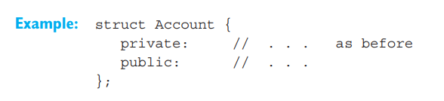
The Keywords class and struct
You can also use the keyword struct to define a class, such as the class Account.
The keywords class and struct only vary with respect to data encapsulation; the default for access to members of a class defined as a struct is public. In contrast to a class defined using the class keyword, all the class members are public unless a private label is used. This allows the programmer to retain C compatibility.

Slide 23
Unions
In normal classes, each data member belonging to an object has its own separate memory space. However, a union is a class whose members are stored in the same memory space. Each data member has the same starting address in memory. Of course, a union cannot store various data members at the same address simultaneously. However, a union does provide for more versatile usage of memory space.

Slide 24
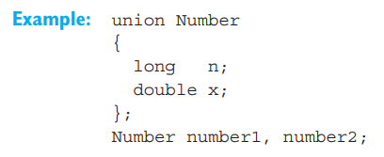
Definition of a Union
Syntactically speaking, a union is distinguished from a class defined as a class or struct only by the keyword union.
This example defines the union Number and two objects of the same type. The union Number can be used to store either integral or floating-point numbers.

Slide 25

Definition of a Union
Unless a private label is used, all union members are assumed to be public. This is similar to the default setting for structures. This allows direct access to the members n and x in the union Number.
The programmer must ensure that the current content of the union is interpreted correctly. This is normally achieved using an additional type field that identifies the current content.
The size of a union type object is derived from the longest data member, as all data members begin at the same memory address. If we look at our example, the union Number, this size is defined by the double member, which defaults to 8 == sizeof(double) byte
EXAMPLE: Defining and using a union
The example defines the union WordByte that allows you to read or write to a 16-bit memory space byte for byte or as a unit.

